Slide 1
Red Black Tree
Course : COMP6048 – DATA STRUCTURE
Year : 2017

Slide 2
Sub Topics
Red Black Tree:
Properties
Application
Operations: Insertion
Operations: Deletion

Slide 3
Red Black Tree Properties
A binary search tree is a red black tree if:
Every node has a color, either red or black.
Root is black by default.
All external nodes are black.
If a node is red, then both its children are black.
The 4th property implies that:
There is no red node has a red parent.
Every simple path from a given node to any of its descendant external nodes contains the same number of black nodes.

Slide 4
Red Black Tree Applications
Red Black Trees offer worst case time guarantee for insertion, deletion, and search operations
Red Black Trees are not only valuable in time-sensitive applications such as real-time applications
Red Black Trees are preferred to be used as a building block in other data structures which provide worst-case guarantee

Slide 5
RBT Operations: Insertion
Insert a new node just like inserting in binary search tree (it should be located in one of the external nodes)
That new node is red
Fix any red black tree violation
If the parent is black, then no violation occurred.
If the parent is red, then violation occurred (no red node has red parent).

Slide 6
RBT Operations: Insertion
Fixing the violation
Let the new node be q, its parent be p, and sibling of parent be s (uncle of q). If parent doesn’t have sibling, then s is black (an external node is black).
If s is red, then change p and s to black and parent of p to red.
If s is black, do rotation (single or double), change the last rotation pivot be black and their child be red.

Slide 7
RBT Operations: Insertion
The new inserted node is X. X’s parent is black, so no violation occurred.
or

Slide 8
RBT Operations: Insertion
The new inserted node is X (or Z in the right picture). Its parent is red, so violation occurred. Its uncle (sibling of its parent) is red, so change its parent and its uncle to black and change its grandparent to red.

Slide 9
RBT Operations: Insertion
The new inserted node is X (or Z in the right picture). Its parent is red, so violation occurred. Its uncle (sibling of its parent) is black and path to its parent is the same with path to its grandparent (left-left or right-right), so single rotate at its grandparent and change its parent to black and its sibling (ex-grandparent) to red.

Slide 10
RBT Operations: Insertion
The new inserted node is X (or Z in the right picture). Its parent is red, so violation occurred. Its uncle (sibling of its parent) is black and path to its parent is different with path to its grandparent (left-right or right-left), so double rotate at its parent and at its grandparent (just like in AVL tree). Change the last rotation pivot to black and their children to red.

Slide 11
RBT Operations: Insertion - Example
A
A
A
G
A is root, so it’s painted BLACK
L
A
L
G
A
Insert: A L G O R I T H M
L

Slide 12
RBT Operations: Insertion - Example
G
G
G
A
O
A
O
A
L
L
R
L
R
O
I
I
G
G
G
A
L
A
O
A
O
O
L
R
L
R
I
T
R

Slide 13
RBT Operations: Insertion - Example
G
G
single rotate
A
O
A
O
L
R
I
R
I
T
H
L
T
H
G
G
double rotate
I
color change
A
O
A
O
G
O
I
R
I
R
A
H
L
R
H
L
T
H
L
T
M
T
M
M

Slide 14
RBT Operations: Deletion
Deleting a node is just like deleting in binary search tree
(if it is a node with two children, find the maximum element in its
left sub-tree or minimum element in its right sub-tree).
Let the node to be deleted be M, and its child be C.
If M is red, then simply replace it with C which must be black by definition.
If M is black and C is red, replace it with C and recolor C with black.
What if M and C are black?

Slide 15
RBT Operations: Deletion
If M and C are black, replace M with C. Let’s denote C in its new position be N (it’s also called a double black), its parent be P, its sibling be S, S_{L} be S’s left child and S_{R} be S’s right child.
If S is red, reverse the color of N and P, and rotate at P.
If S, S_{L} and S_{R} are black, then recolor S as red.
If S is black and S_{L} or S_{R} is red, then single rotate or double rotate.

Slide 16
RBT Operations: Deletion
a is a double black node, its sibling is red so rotate at X and recolor X and Y.

Slide 17
RBT Operations: Deletion
a is a double black node, its sibling is black and both its sibling children are black, so recolor its sibling to red.

Slide 18
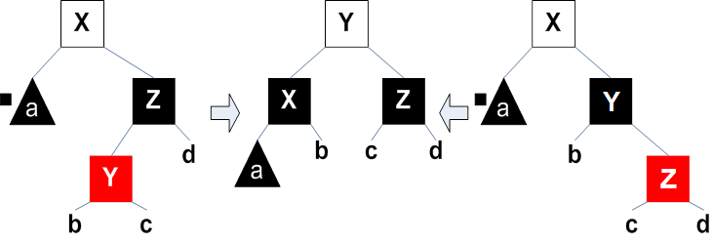
RBT Operations: Deletion
a is a double black node, its sibling is black and one of its sibling’s children is red, so do single/double rotation.

Slide 19
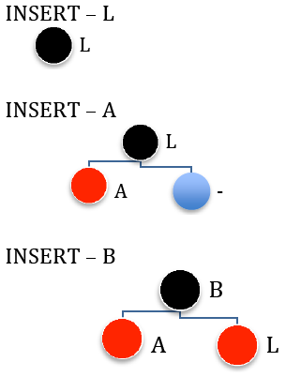
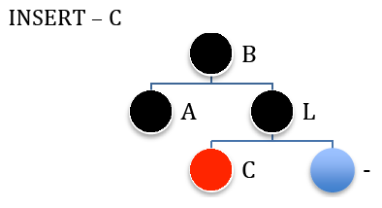
Insertion Example
Inserting string “LABCOMPUTING” (1)

Slide 20
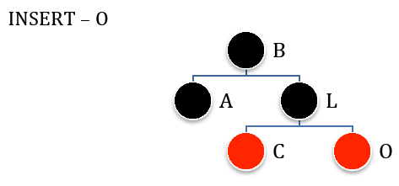
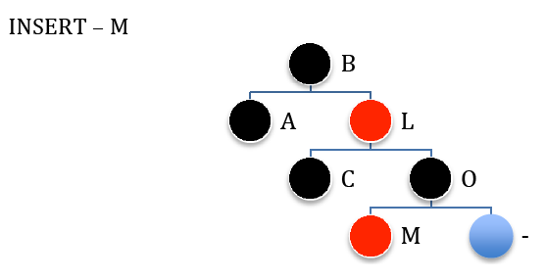
Insertion Example
Inserting string “LABCOMPUTING” (2)

Slide 21
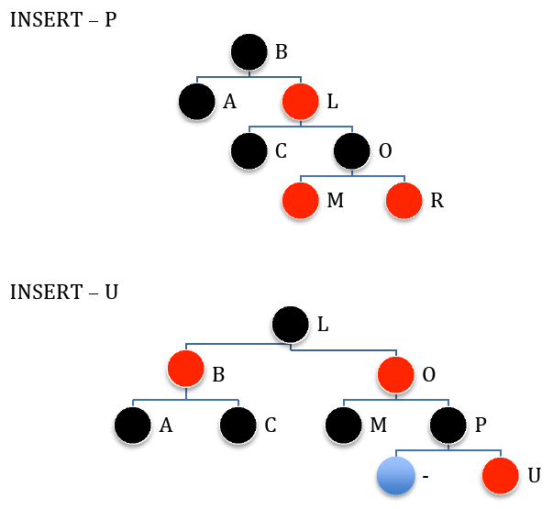
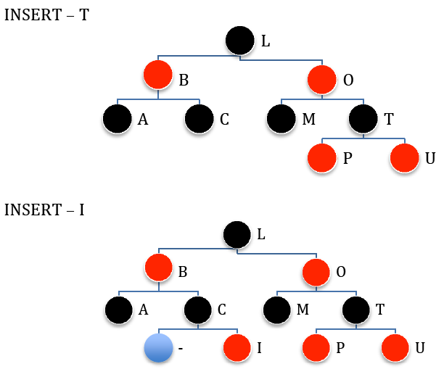
Insertion Example
Inserting string “LABCOMPUTING” (3)

Slide 22
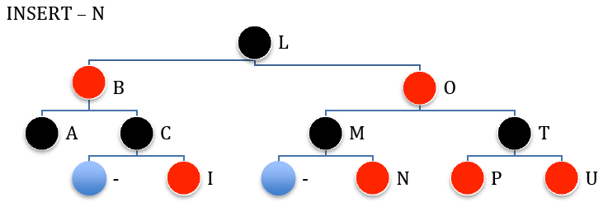
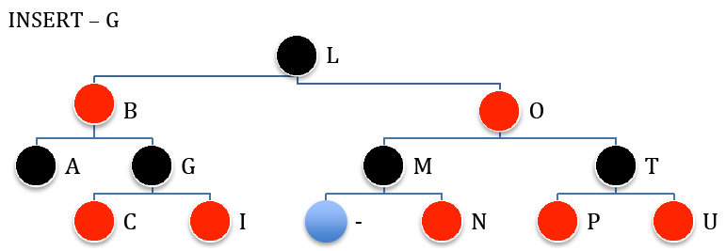
Insertion Example
Inserting string “LABCOMPUTING” (4)

Slide 23
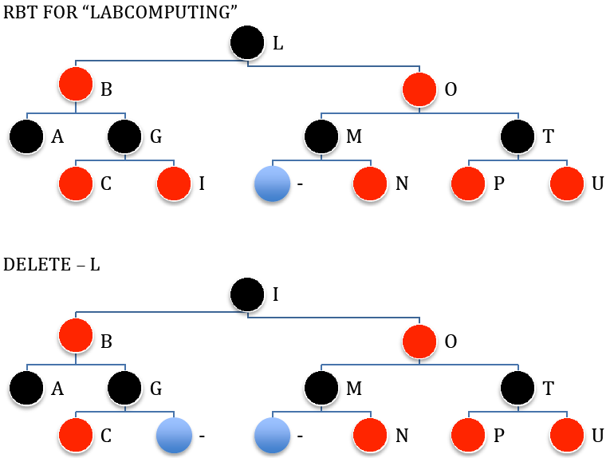
Deletion Example
Deleting string “LABCOMPUTING” (1)

Slide 24
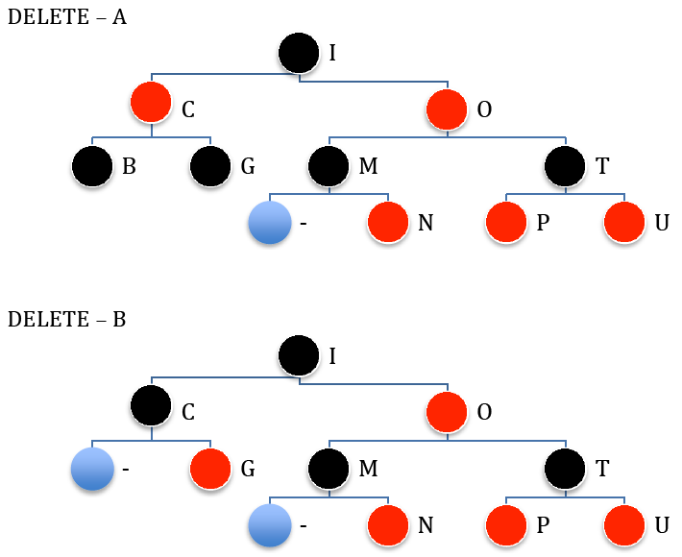
Deletion Example
Deleting string “LABCOMPUTING” (2)

Slide 25
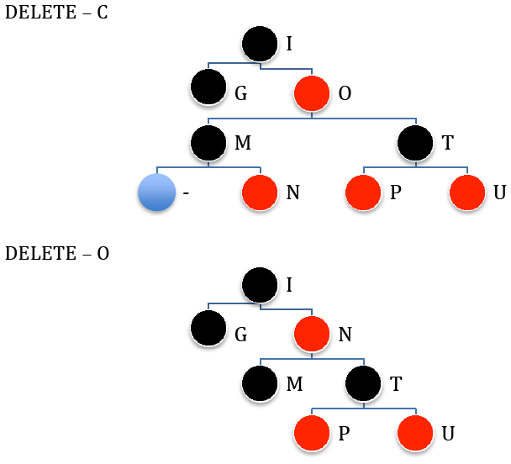
Deletion Example
Deleting string “LABCOMPUTING” (3)

Slide 26
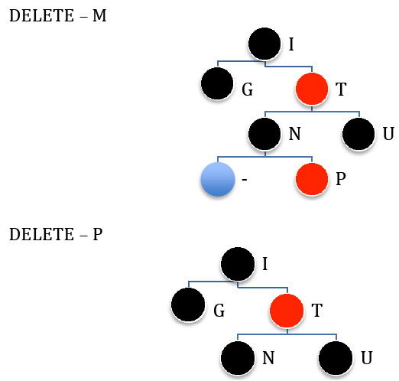
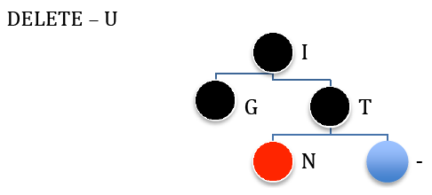
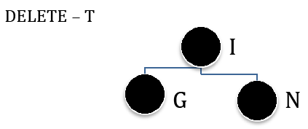
Deletion Example
Deleting string “LABCOMPUTING” (4)

Slide 27
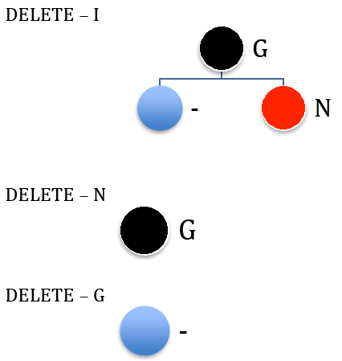
Deletion Example
Deleting string “LABCOMPUTING” (5)

Slide 28
EXERCISE

Slide 29
References
Reema Thareja,. 2014. Data structures using C. OXFOR. New Delhi. ISBN:978-0-19-809930-7 Chapter 10
Red Black Tree
https://www.cs.usfca.edu/~galles/visualization/RedBlack.html
Red Black Tree
https://www.cs.auckland.ac.nz/software/AlgAnim/red_black.html

Slide 30
END
Red Black Tree

